Slide 1
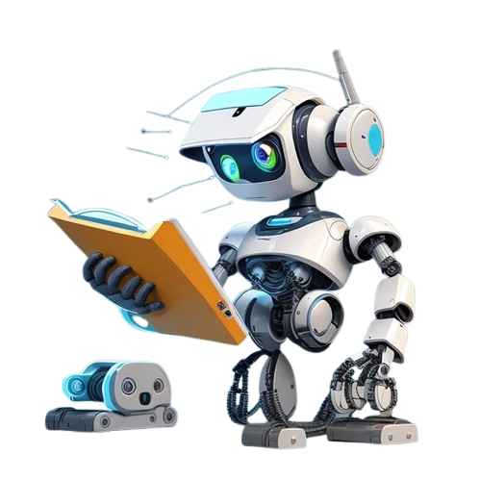



AI MODEL TRAINING
FOR
DOCUMENT INTELLIGENCE
By Chakin Kim
Power Learn Project Academy

Slide 2



FROM CHAOS TO ORDER!
Notes:
Why Document Intelligence?
Automatically extracting totals from receipts.
Sorting emails into spam/inbox.
Digitizing handwritten notes.
Impact: Saves time, reduces errors, and unlocks insights from unstructured data.

Slide 3
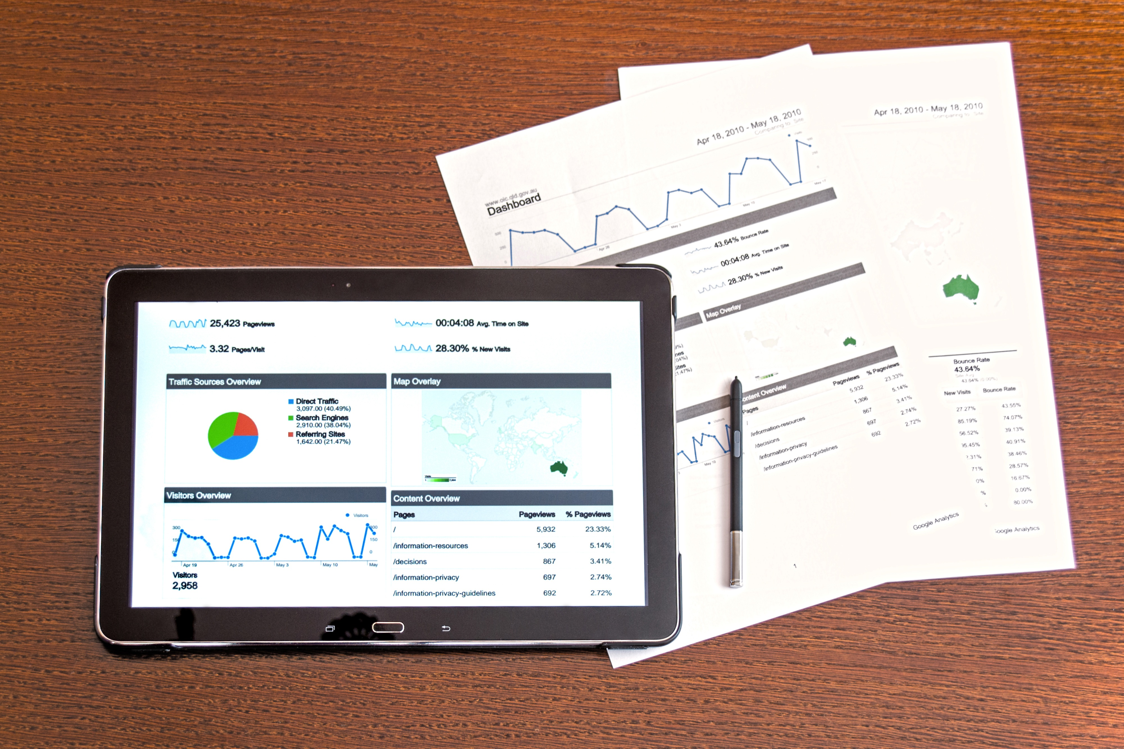
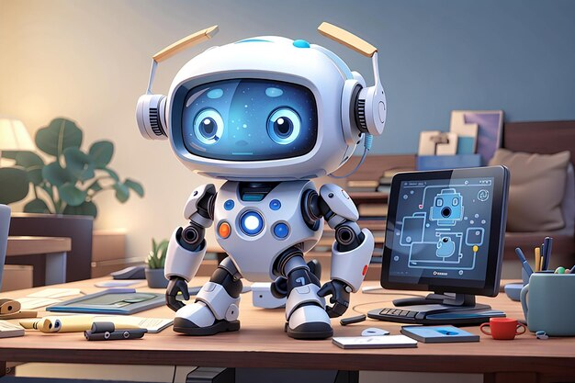
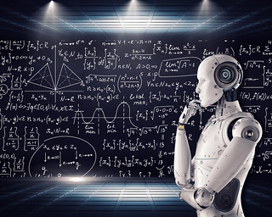


Table Of Contents
Starter
Cuisine
Party
AI
Modelling
Document Intelligence
Hands-On Practice

Slide 4
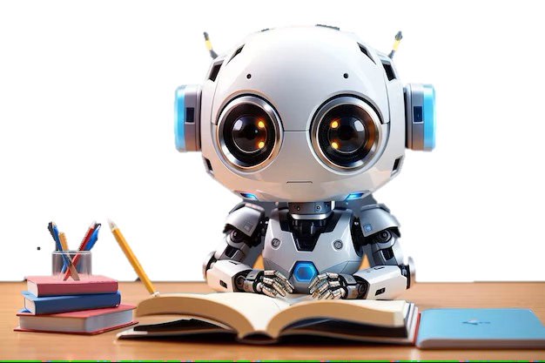

1
What is AI?
What time is it? ⏳
It’s time for
Artificial Intelligence⌚

Slide 5
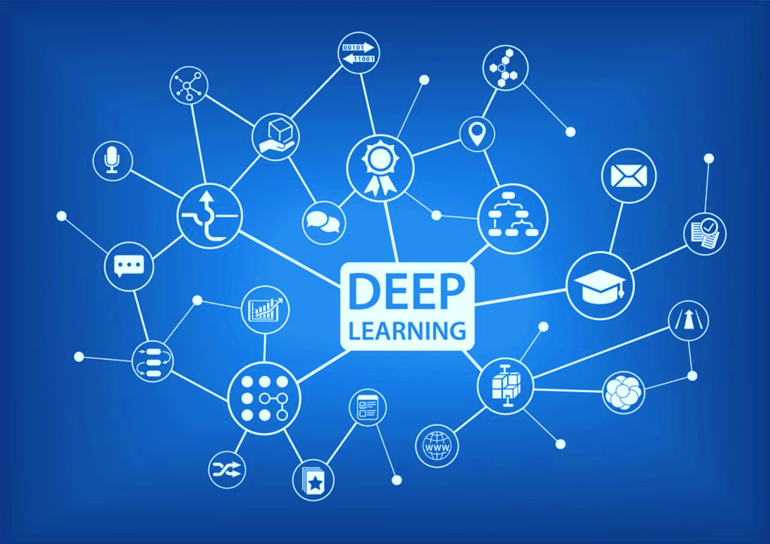
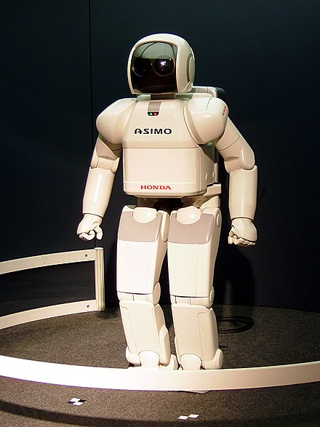
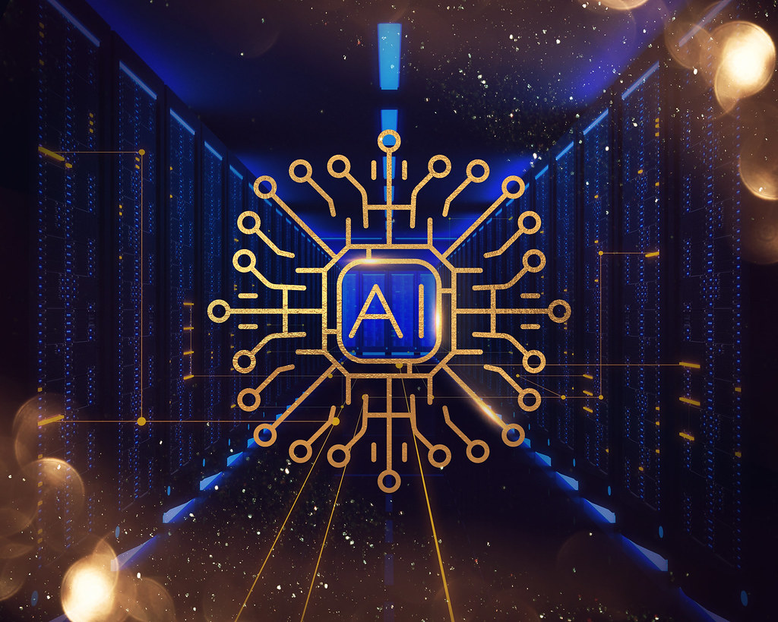
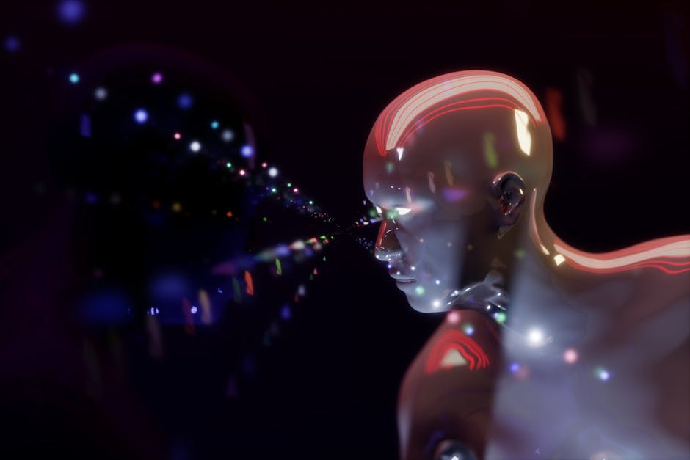
Artificial Intelligence is:
AI
Machine Learning
Deep Learning
Robotics
Simulating human behavior on computers.
Training computers to understand data.
Enabling computers to extract data.
Computers acting like humans.

Slide 6
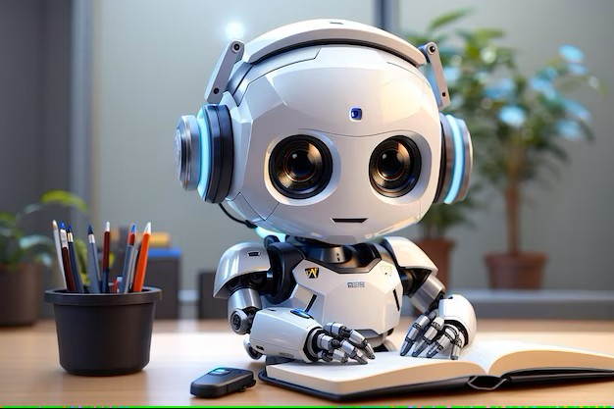
AI Modeling
Imagine teaching a toddler to recognize cats. You show them lots of cat pictures 🐱, point out features like whiskers and tails, and eventually, they learn to shout “CAT!” when they see one.
AI modeling works similarly! It’s like training a “digital brain” by feeding it tons of examples (data) so it can learn patterns and make smart guesses (like spotting cats, predicting the weather, or recommending your next Netflix binge).
In a nutshell:
AI model = Recipe + Data + Practice → Smart decisions!
No magic, just math + practice—and voilà, your AI becomes a mini-expert! 🧠✨
Notes:
Imagine teaching a toddler to recognize cats. You show them lots of cat pictures 🐱, point out features like whiskers and tails, and eventually, they learn to shout “CAT!” when they see one.
AI modeling works similarly! It’s like training a “digital brain” by feeding it tons of examples (data) so it can learn patterns and make smart guesses (like spotting cats, predicting weather, or recommending your next Netflix binge).

Slide 7
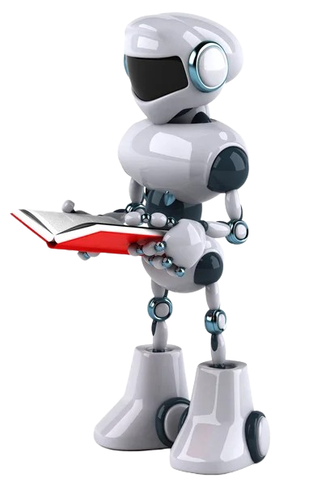
2
What is DI?
Document Intelligence = Your lazy Sunday but for boring admin tasks. Let the robots handle the paper cuts! 🦾📑✨
Notes:
Document Intelligence (DI) is the application of artificial intelligence (AI) and machine learning (ML) technologies to automate the processing, understanding, and analysis of structured and unstructured documents. It transforms raw text, images, and data within documents into actionable insights, enabling systems to mimic human-like content comprehension.

Slide 8
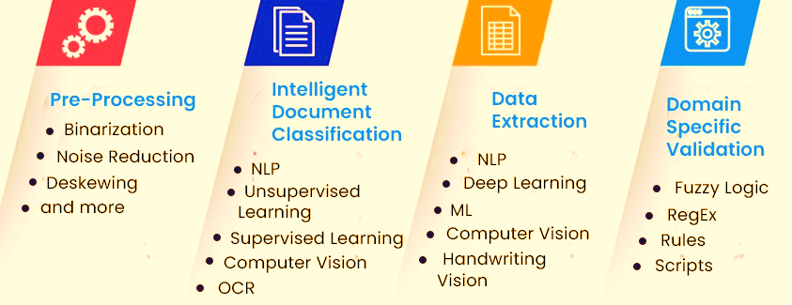

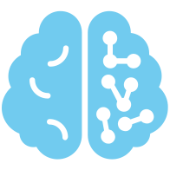
Document Intelligence Processing

Slide 9
Let’s apply DIP 📄 AI Document Digitization in Healthcare
1. 🧹 Pre-Processing: The "Clean-Up Crew"
2. 🧠 Intelligent Classification: The "Sorting Hat"
3. 🔍 Data Extraction: The "Treasure Hunter"
4. ✅ Domain Validation: The "Fact Checker"
Before AI can work, it tidies up!
Binarization: Turns docs black-and-white (like a fancy photocopier).
Noise Reduction: Erases coffee stains & crumples (goodbye, latte accidents!).
Deskewing: Fixes crooked scans (no more sideways prescriptions!).
“Is this a lab report or a patient form?” AI uses:
OCR: Reads text from images (like a robot librarian 📖).
NLP: Understands context (e.g., “Patient BMI: 24” = health data!).
Computer Vision: Spots logos, tables, or handwritten notes (👀 I see you, Dr. Scribble!).
Digs out hidden gems from the docs!
Deep Learning: Finds patterns (e.g., “Medication: [illegible word] → Amoxicillin”).
Handwriting Vision: Decodes doctor handwriting (🖋️ It’s a superhero skill).
“Does this make sense for healthcare?”
Fuzzy Logic: Guesses missing info (e.g., “Patien… Smith” → “Patient: John Smith”).
RegEx: Matches patterns (e.g., spots a phone number: +254-712-345-678).
Rules: Flags weird stuff (e.g., “Blood Pressure: 300/200” → 🚨 Alert!).
Notes:
Imagine your messy desk is a pile of medical forms, prescriptions, and scribbled notes. AI to the rescue! Here’s how it turns chaos into clean, digital magic:

Slide 10
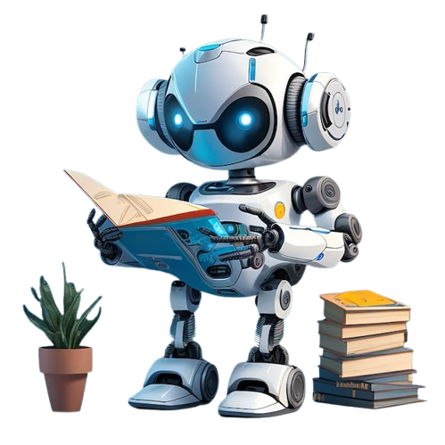
Why Should You Care?
1. No more lost files:
2. Speed:
AI organizes your clinic’s paper avalanche. 🏔️→📂
Processes forms faster than you can say “stethoscope”! 🏃♂️💨
3. Fewer errors:
Bye-bye, typos in patient records! 👋❌

Slide 11
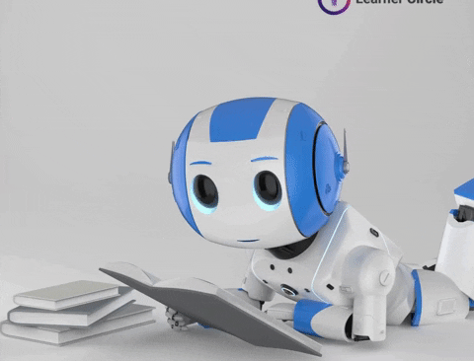
🎉 Fun Fact:
AI once read a doctor’s note that said “rest for 2 weeks” as “eat tacos weekly”. Thankfully, validation rules saved the patient’s diet! 🌮😜
Notes:
It’s like giving your clinic a robot intern that never sleeps, never complains, and loves paperwork. 🤖💖

Slide 12
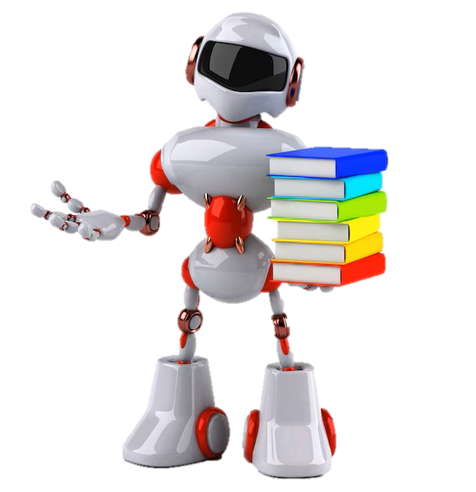
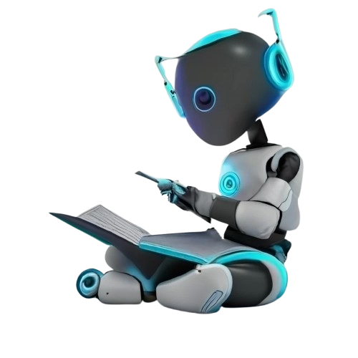
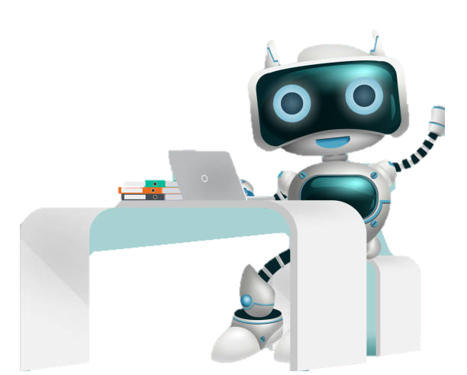
HANDS-ON
Clone this GitHub Repo
https://github.com/chankjen/AI_MasterClass.git

